Slide 1
Analyzing Performance of Regression models

Slide 2
Loss Function
Objective function that our model tries to minimize in the training phase
helps the model to make better predictions by penalizing it when it makes mistakes
Negative oriented , lower is always better
model is highly penalized when loss is higher

Slide 3
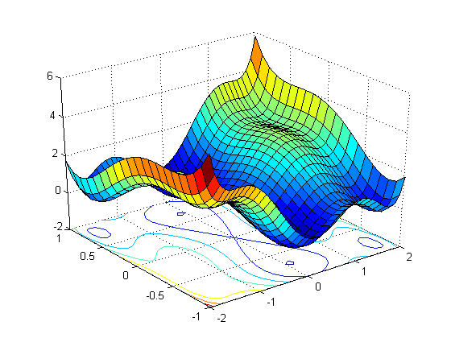
Loss Function
Two major loss functions for regression models are
MAE - Mean Absolute Error
RMSE - Root mean squared error

Slide 4
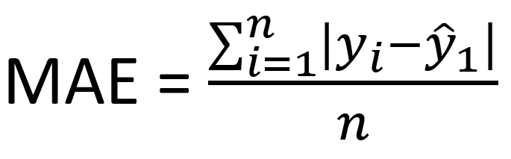
MAE - Mean Absolute Error
Avg. magnitude of the errors in predictions compared to original values

Slide 5
MAE - Example
Original value | Predicted value | Absolute error
21 | 17 | 4
18 | 21 | 3
6 | 6 | 0
9 | 7 | 2
23 | 19 | 4
→ |18 -21| = |21-18| = 3
MAE = 4 + 3 + 0 + 2 + 4 = 2.6
5

Slide 6
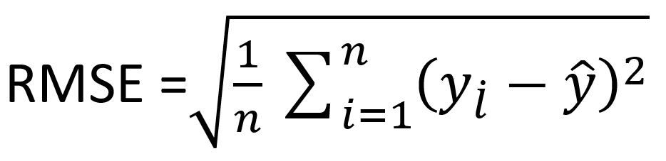
RMSE - Root mean squared error
Root over mean of Squared difference between Original and Predictions

Slide 7
RMSE - Root mean squared error
Original value | Predicted value | Squared error
21 | 17 | 16
18 | 21 | 9
6 | 6 | 0
9 | 7 | 4
23 | 19 | 16
→ (18 -21)^2 = 9
MSE = 16 + 9 + 0 + 4 + 16 = 9
5
RMSE = √9 = 3

Slide 8
Which one is better ?
Both MAE and RMSE range from 0 to infinite but the value of RMSE is always greater than or equal to MAE.
Errors are squared before they are averaged, the RMSE gives a relatively high weight to large errors.

